Slide 1
CYBERSECURITY / PRACTICAL ASSESSMENT
BOUNTY
HACKER
Penetration Testing Lab Report
Project title : Modeling Data leakage pathways and archive command privilege escalation in cloud services
Prepared by: Nikhil Patel
Collage : Rungta College of Engineering and technology

Slide 2
01 / OVERVIEW
Project objective & scope
A controlled learning exercise focused on enumeration, access validation and privilege review.
OBJECTIVE
SCOPE
OUTPUT
To assess the target’s exposed services, investigate potential security weaknesses, and review privilege permission in the authorized TryHackMe Bounty hacker lab.
The assessment is limited to the assigned TryHackMe Bounty Hacker machine lab it’s authorize lab environment.
A technical report containing verified findings, supporting screenshots, risk assessment, and remediation recommendations.
Assessment type: CTF / educational penetration-testing lab
Evidence rule: Replace placeholders with screenshots from your own run; do not claim unverified results.
Safety boundary: Do not scan or test systems outside the authorized lab.
BOUNTY HACKER / TRYHACKME LAB REPORT
02 / 10

Slide 3
02 / METHODOLOGY
Tools & workflow
The exact output depends on the currently deployed room instance.
01
Reconnaissance
02
Enumeration
03
Initial access
04
Privilege review
Evidence & reporting
05
Tool : Nmap
Identify target IP and map exposed services.
Tool : FTP client
Review FTP access and available files.
Tool : SSH
Validate credentials only within the lab; document SSH access.
Tool : Linux commands
Inspect sudo -l permissions and assess misconfiguration.
Tool : Screenshots + Google Sheets
Record proof, impact, and remediation.
Tools may include Nmap, an FTP client, SSH, and standard Linux enumeration commands.
Record tool versions and actual commands in the accompanying Google Sheet.
BOUNTY HACKER / TRYHACKME LAB REPORT
03 / 10

Slide 4
03 / RECONNAISSANCE
Service discovery with Nmap
Run against the target IP assigned by TryHackMe, not a public or unrelated host.
COMMAND
nmap -sC -sV <MACHINE_IP>
Purpose: Discover open ports and identify likely service versions.
Capture: Target IP, scan command, timestamp, and open-port output.
Interpretation: Use the observed output as evidence; do not assume expected ports are present.
BOUNTY HACKER / TRYHACKME LAB REPORT
04 / 10

Slide 5
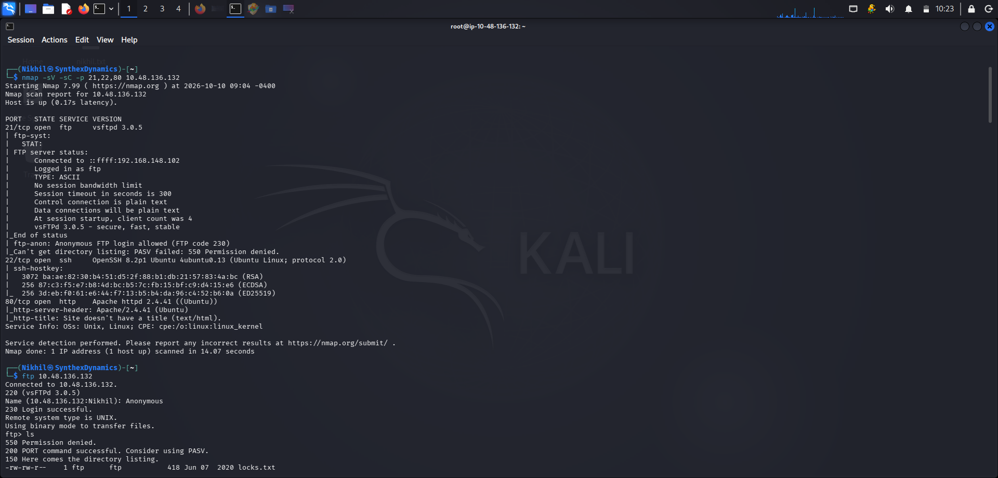

Slide 6
Findings using Nmap
PORT
STATE
SERVICE
VERSION
21/tcp
open
FTP
Vsfpd 3.0.5
22/tcp
open
SSH
Openssh 8.2p1
80/tcp
open
HTTP
Apache httpd 2.4.41

Slide 7
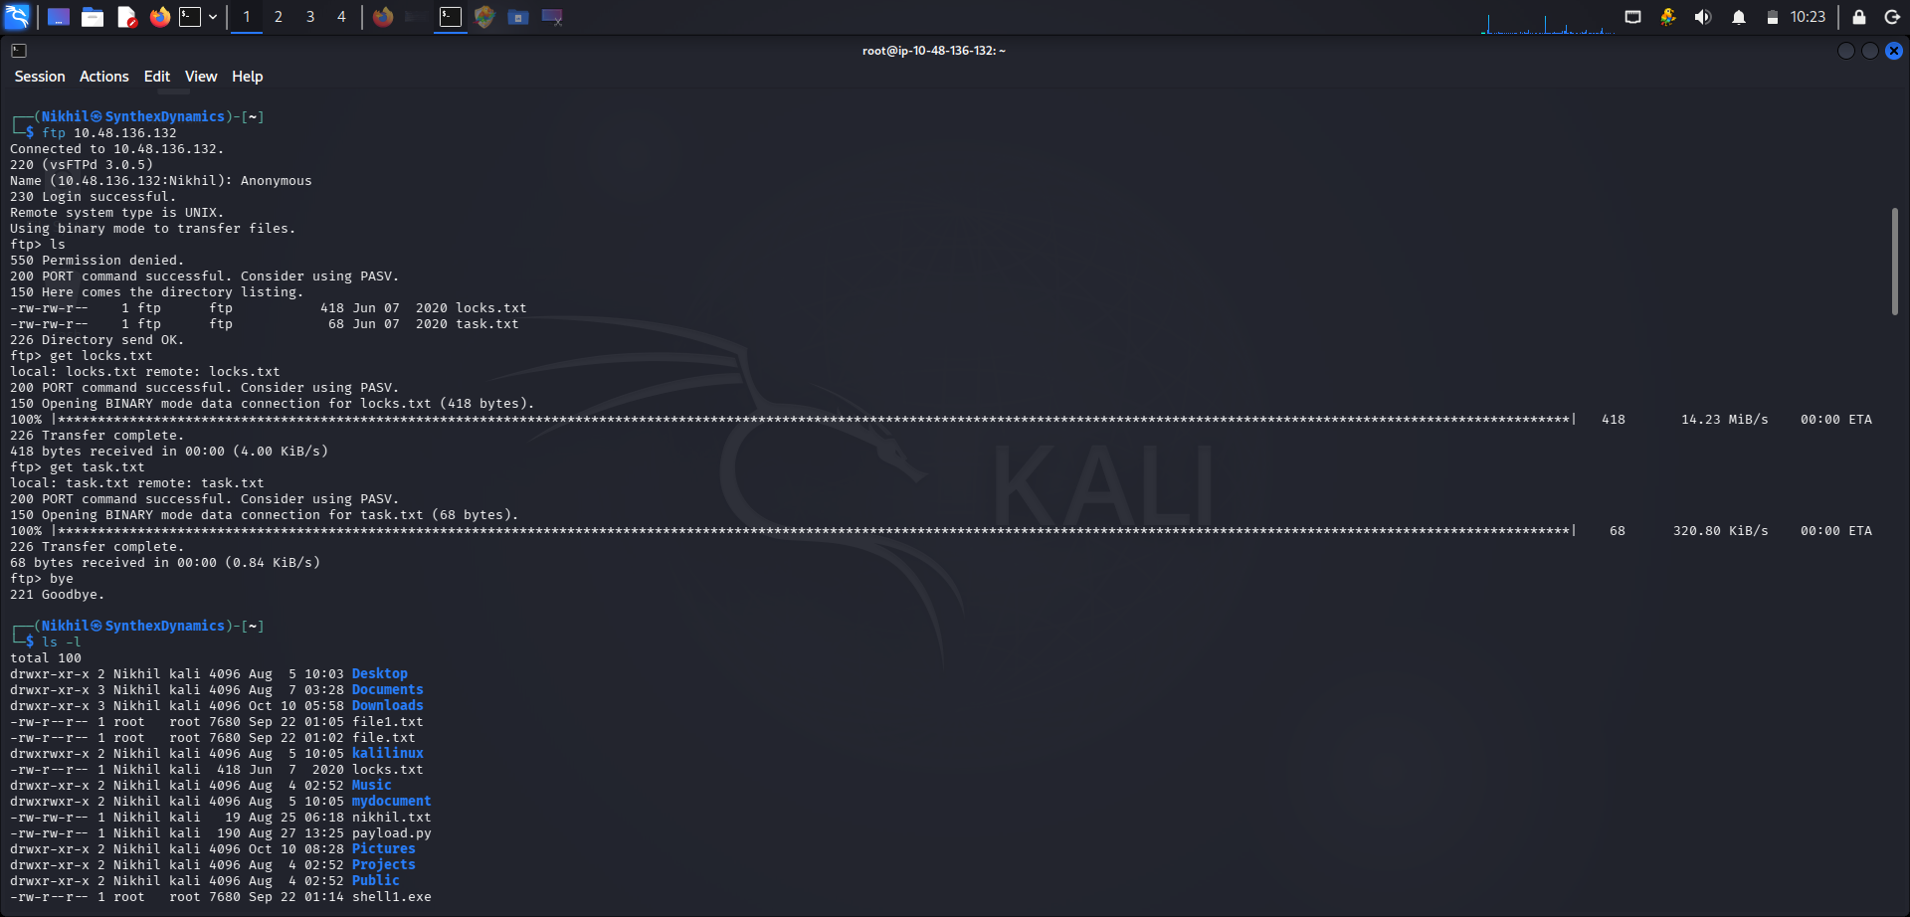
04 / ENUMERATION
FTP access & file review
Confirm the service and permissions from your own lab session.
WHAT TO RECORD
Was anonymous access allowed? Which filenames were visible? What permissions were observed?
EVIDENCE TO ADD
FTP listing and a safe view of relevant task files. Avoid exposing credentials in screenshots.
If access differs from the expected room walkthrough, report what you observed rather than forcing a result.
BOUNTY HACKER / TRYHACKME LAB REPORT
05 / 10

Slide 9
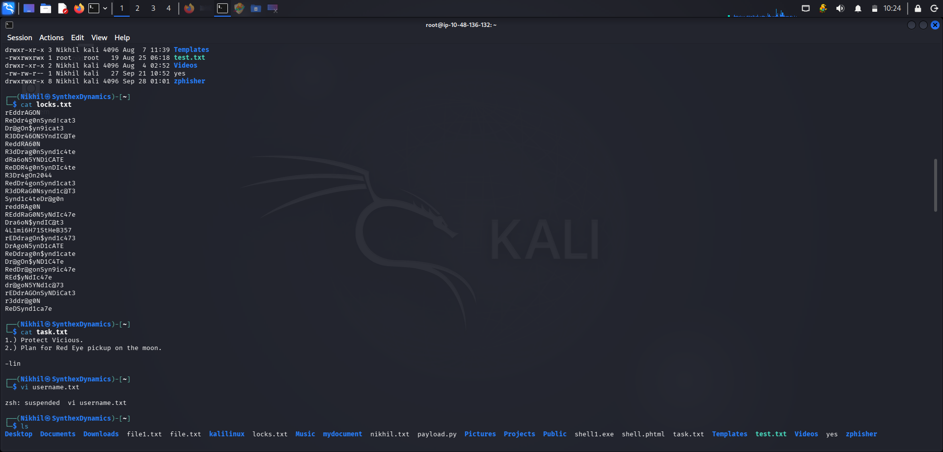

Slide 10
05 / INITIAL ACCESS
Credential validation & SSH
Keep credentials private; document the outcome without publishing passwords.
INPUTS
VALIDATION
PROOF
Username source, provided wordlist, target SSH service.
Record whether authorized lab credential testing succeeded or failed.
SSH session evidence, account name, and a redacted view of user-level access.
▣
▣
SCREENSHOT PLACEHOLDER 03
SCREENSHOT PLACEHOLDER 04
SSH session / account verification
User flag proof (redact the flag if sharing publicly)
BOUNTY HACKER / TRYHACKME LAB REPORT
06 / 10

Slide 11
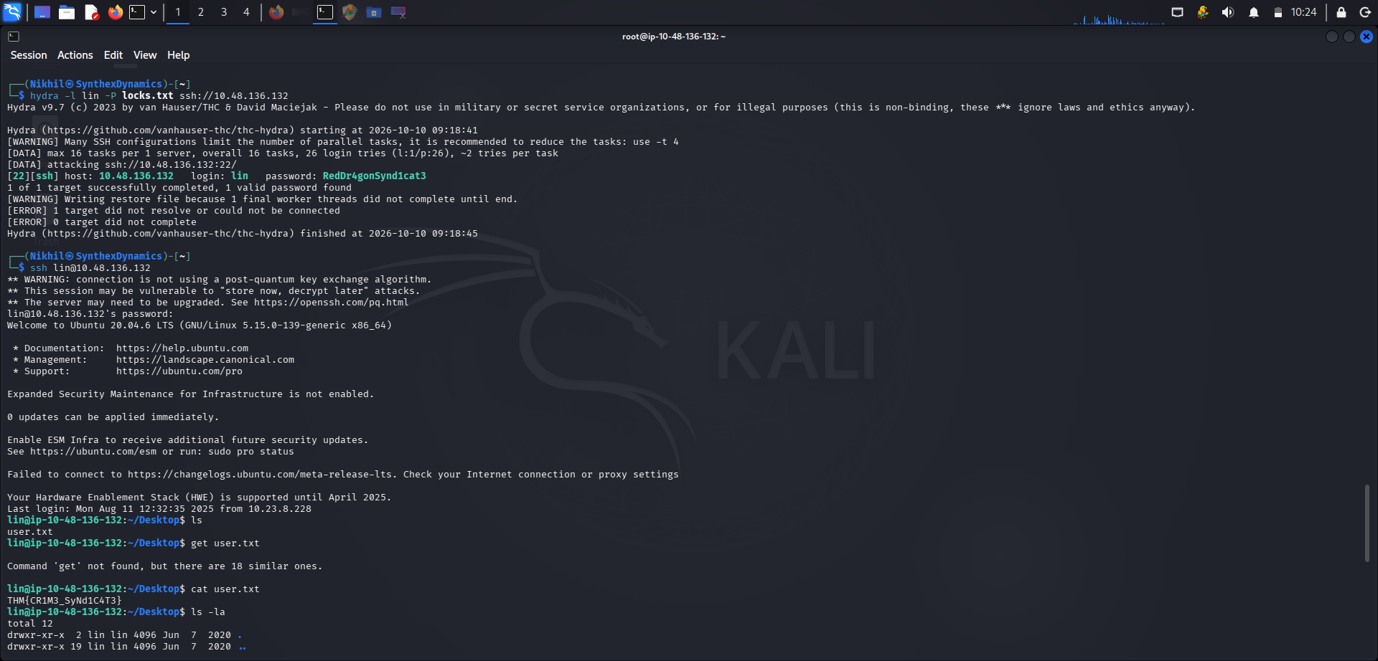

Slide 12
06 / PRIVILEGE REVIEW
Sudo permissions & root verification
Privilege escalation should be documented as a finding, not just as a command sequence.
ENUMERATION
POTENTIAL ISSUE
VERIFICATION
sudo -l
Review permitted commands and execution context.
If `tar` is permitted with elevated privileges, assess whether that permission is excessive.
Confirm the effective account with `id`; only report root access if observed.
▣
▣
SCREENSHOT PLACEHOLDER 05
SCREENSHOT PLACEHOLDER 06
sudo -l output
Privilege verification / root flag proof
BOUNTY HACKER / TRYHACKME LAB REPORT
07 / 10

Slide 13
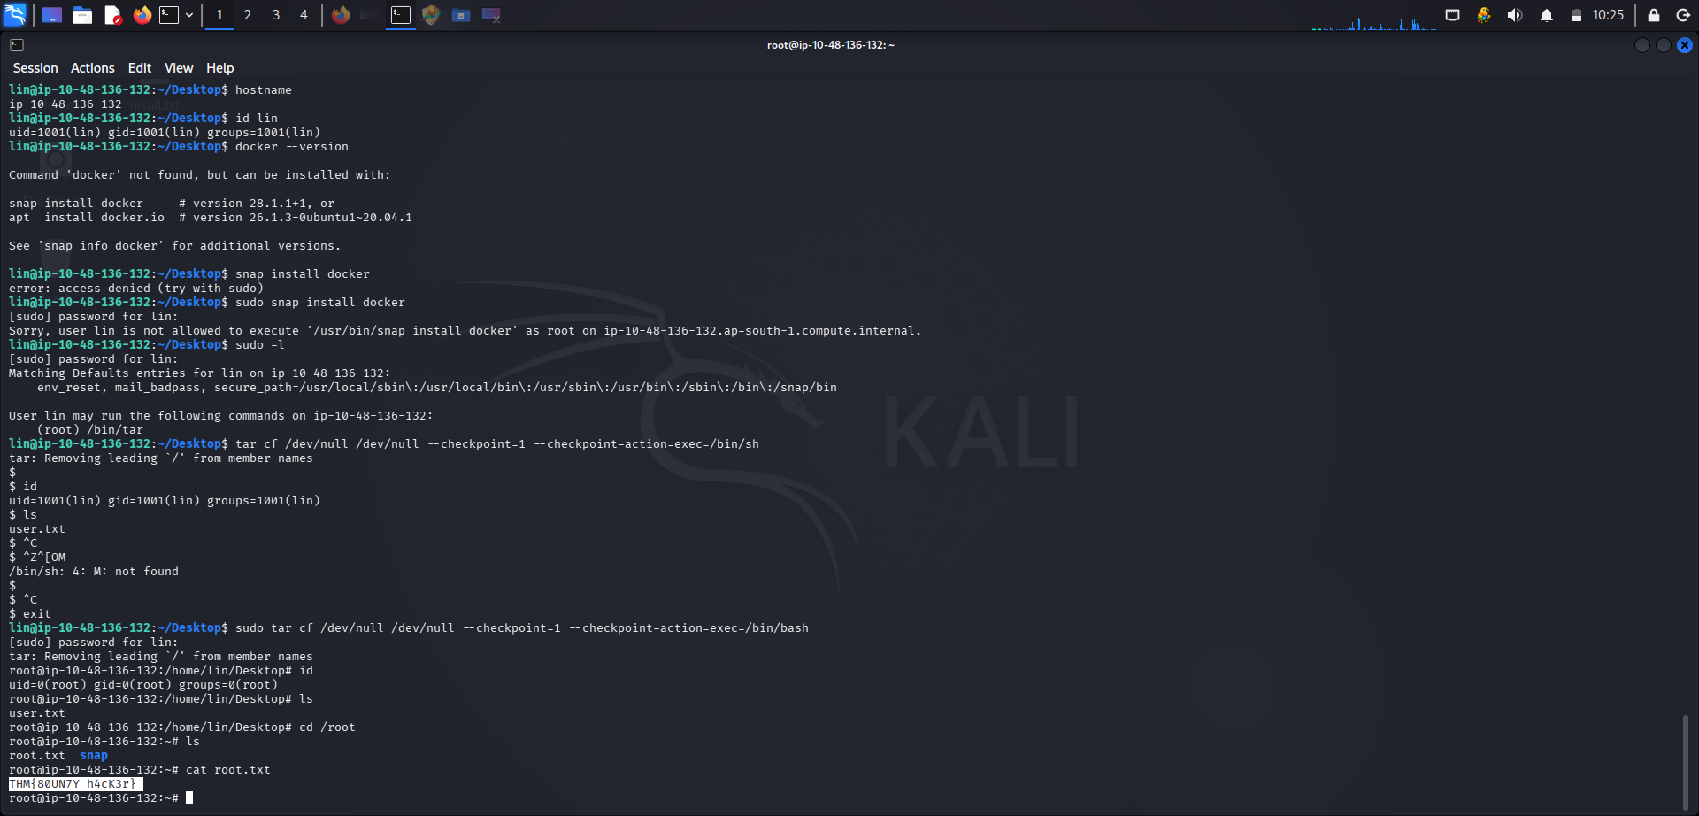

Slide 14
07 / FINDINGS
Potential security issues to validate
These are assessment hypotheses until supported by your captured evidence.
Finding
Evidence needed
Potential impact
Initial rating
Status
Anonymous FTP
FTP login result and accessible file listing
Unauthorized file access
Medium*
Unverified
Weak credentials
Verified authentication result
Unauthorized account access
High*
Unverified
Sudo misconfiguration
`sudo -l` output and verified permissions
Privilege escalation
High/Critical*
Unverified
BOUNTY HACKER / TRYHACKME LAB REPORT
08 / 10

Slide 15
08 / REMEDIATION
Recommended security controls
Recommendations should address the confirmed root cause of each finding.
01
FTP hardening
Disable anonymous FTP access when not required; restrict file and directory permissions; remove sensitive information from publicly accessible files.
02
Credential security
Use unique, strong passwords or SSH keys; disable password-based SSH authentication where appropriate; monitor repeated failed login attempts.
03
Least privilege
Grant only the sudo permissions required for each role; restrict access to powerful utilities; review privileged permissions regularly.
04
Detection & response
Monitor authentication logs, unusual file access, and privileged command execution; investigate suspicious activity and retain relevant logs.
BOUNTY HACKER / TRYHACKME LAB REPORT
09 / 10

Slide 16
09 / WRAP-UP
Conclusion & lessons learned
The assessment demonstrates how systematic enumeration, evidence-based validation, and practical remediation support effective security testing.
TECHNICAL LEARNING
REPORTING LEARNING
Service enumeration using Nmap, FTP/SSH investigation, Linux permission review, and evidence collection in an authorized lab.
Documenting verified findings, recording reproducible evidence, assessing risk carefully, and recommending practical security controls.
Thank you
BOUNTY HACKER / TRYHACKME LAB REPORT
10 / 10

